Slide 1
Regression Techniques for Validation of relationship between Resilience & Covid-19
Ishrat Zaman
Advisor- Prof. Jodi Mead
Dept. of Mathematics Boise State University

Slide 2
1. Community Resilience
The sustained ability of communities to withstand, adapt to, and recover from adversity.
A resilient community can spontaneously emerge or adapt when a shock happens but may disappear when the crisis is over.
A resilient community is socially connected and has accessible health systems that can withstand disaster and foster community recovery.
The community can take collective action after an adverse event.
Community resilience is the capacity of individuals and households within a community to absorb, endure, and recover from the impacts of a disaster.

Slide 3
2. Community Resilience Estimates (CRE Tool)
The Community Resilience Estimates (CRE) is a resilience measure that identifies a community’s ability to endure, respond and recover from the impact of disasters.
CRE are experimental estimates produced using information on individuals and households from the 2018 American Community Survey, the Census Bureau’s Population Estimates Program ,and publicly available health condition rates from the National Health Interview Survey.
Local planners, policy makers, public health officials, and community stakeholders use the estimates as one tool to help assess the potential resiliency of communities and plan mitigation strategies but can easily be modified for a broad range of natural disasters (hurricanes, tornadoes, floods, etc.).
CRE, in their current form, are specific to the current COVID-19 pandemic.
Source:https://www.census.gov/library/stories/2020/06/how-resilient-are-communities-to-disasters.html

Slide 4
Risk Factor
Risk Factors Resilience to a disaster is partly determined by the vulnerabilities within a community. In order to measure these vulnerabilities, and construct the community resilience estimates, an individual risk index is designed. The risk index is a weighted aggregate of the risk factors.
The risk factors are binary components that add up to 11 possible risks in the risk index.
Based on all risk factors, counties are categorized with zero risks, 1-2 risks, 3+ risks.
Income-to-Poverty Ratio | No Health Insurance Coverage
Single or zero caregiver household | Age>=65
Household Crowding | Serious Heart Condition
Communication Barrier | Diabetes
No Employed Person | Asthma
Disability Posing Constraint to Significant Life Activity

Slide 5
Covid-19
The COVID-19 pandemic makes up a global health shock, with a death toll of over 4.5 million and over 216 million people reported ill by 29 August 2021.
Idaho has a death toll of 2,333 and over 220K reported ill by august 29.
Community resilience can play a major role in coping with shocks, such as Covid-19 pandemic.
Source: Johns Hopkins (CSSE). Time Series Covid19 US [All data is read in from the daily case report.]
https://github.com/CSSEGISandData/COVID19/tree/master/csse_covid_19_data/csse_covid_19_time_series

Slide 6
Topic Area
In this thesis, we focus on Idaho resilience regarding Covid confirmed cases and death cases. Here we use CRE tool to measure resilience.
The major contribution of our study lies in the exploration of the connection between resilience indices and COVID-19 cases and deaths.

Slide 7
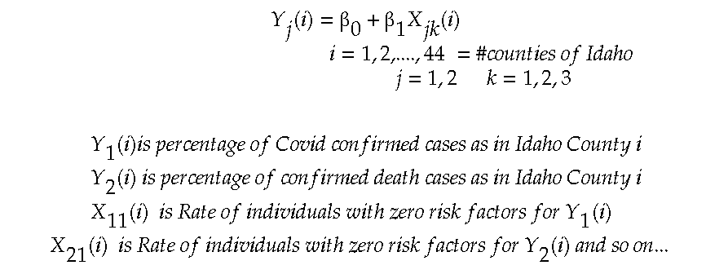
Regression
The first model examines the effect of resilience indicators on the number of confirmed COVID cases:

Slide 8
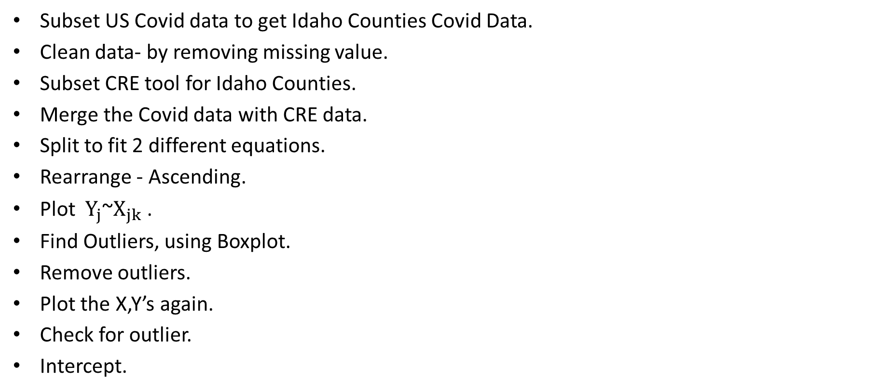
Data Processing
Subset US Covid data to get Idaho Counties Covid Data.
Clean data- by removing missing value.
Subset CRE tool for Idaho Counties.
Merge the Covid data with CRE data.
Split to fit 2 different equations.
Rearrange - Ascending.
Plot$Y_{j}$~$X_{jk}$ .
Find Outliers, using Boxplot.
Remove outliers.
Plot the X,Y’s again.
Check for outlier.
Intercept.

Slide 9
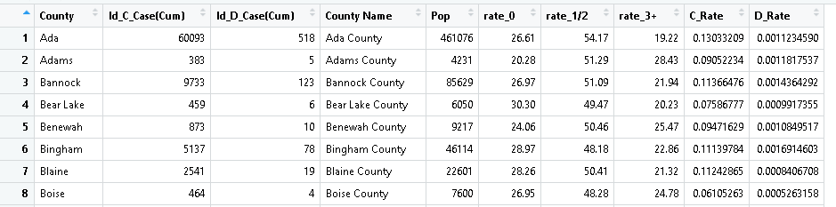
First 8 Rows after merging:

Slide 10
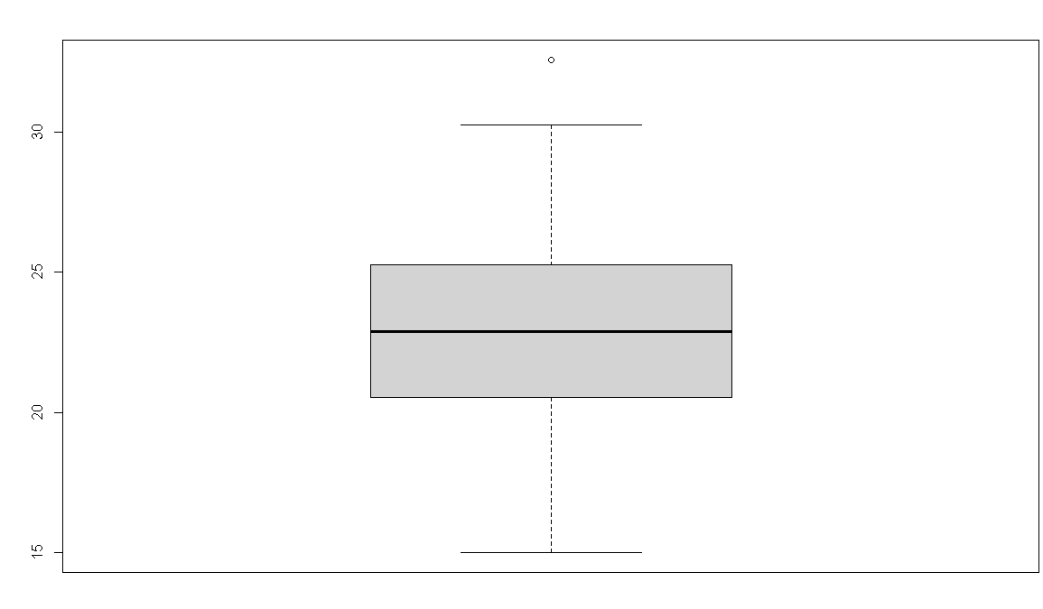
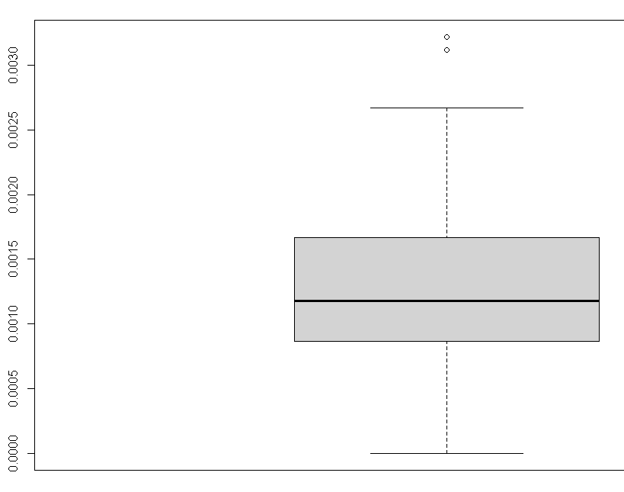
Boxplot of Y1 data (Confirmed cases)
Boxplot of Y2 data (Death cases)

Slide 11
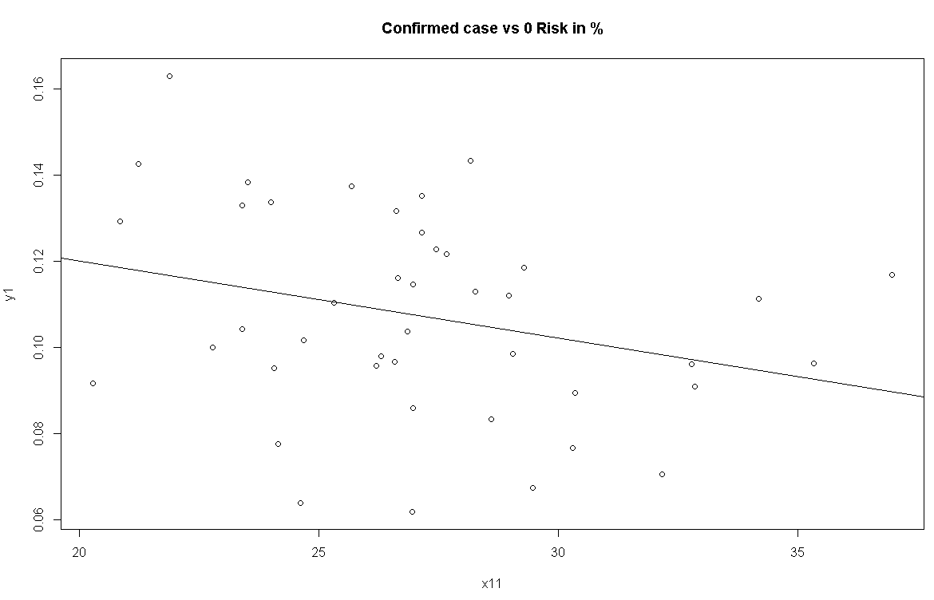
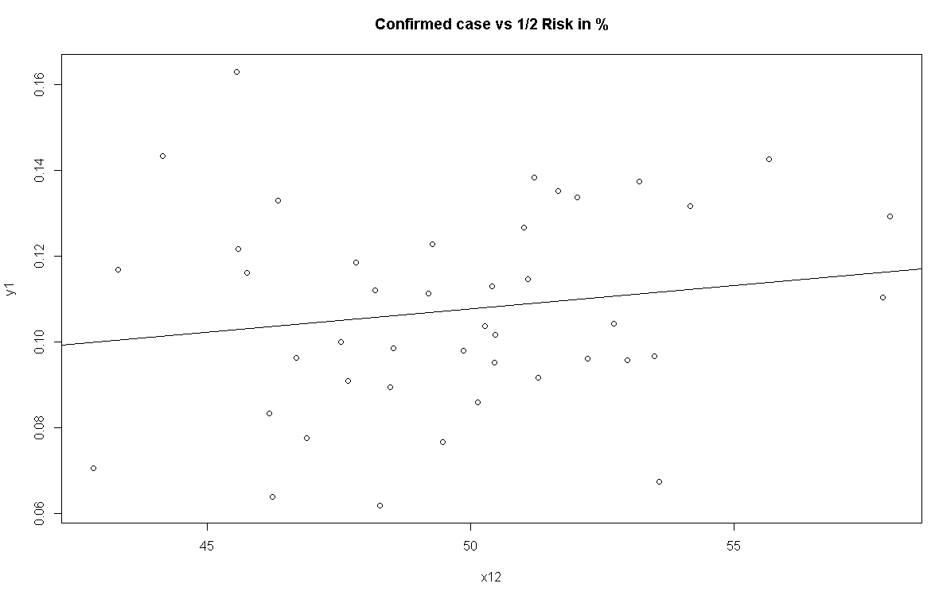
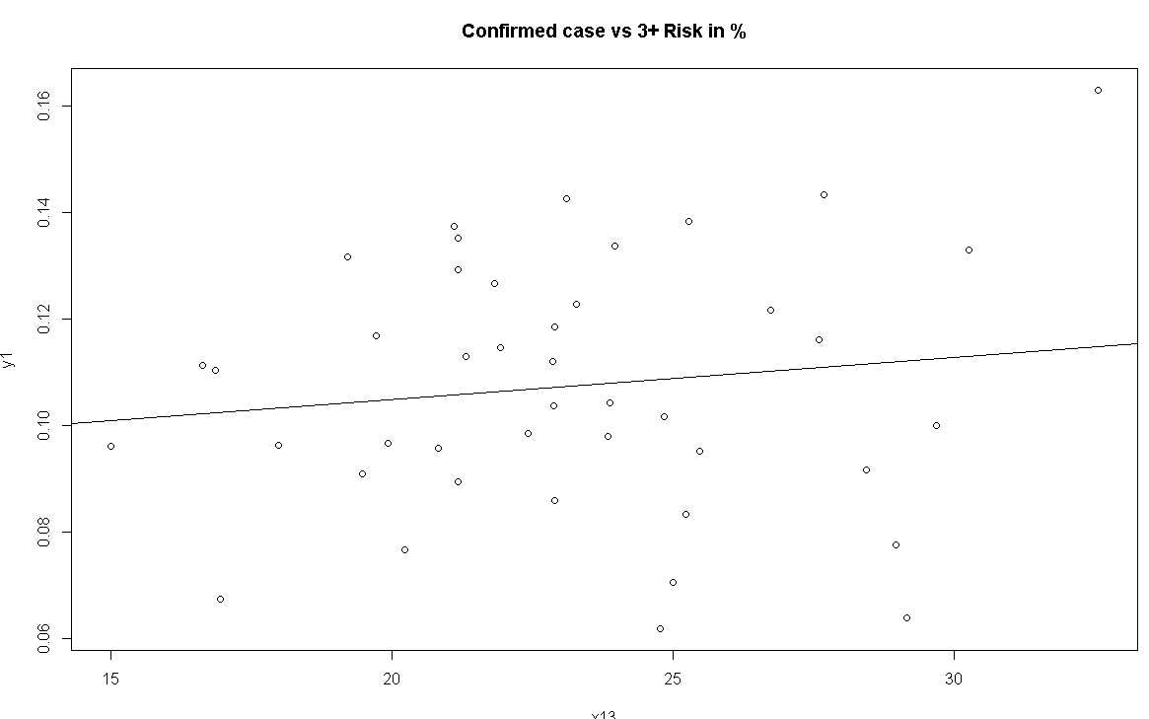

Slide 12
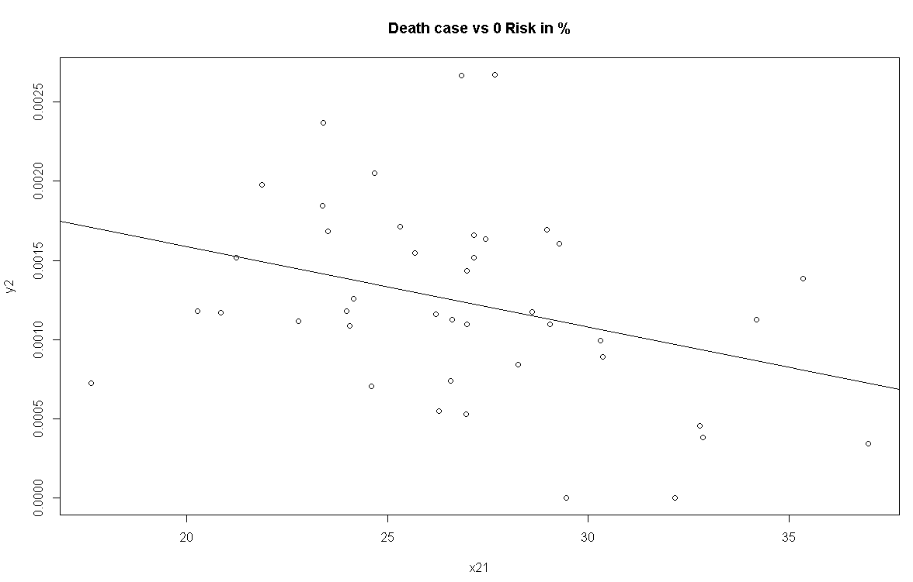
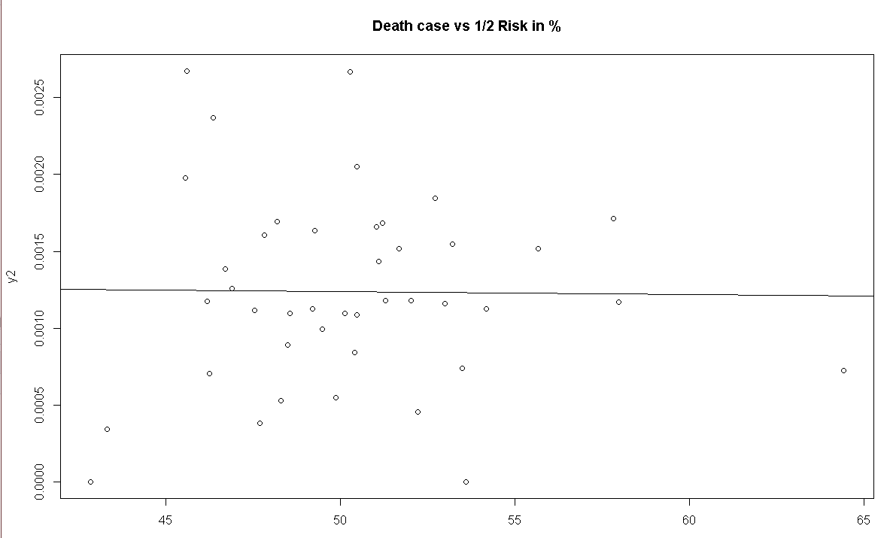
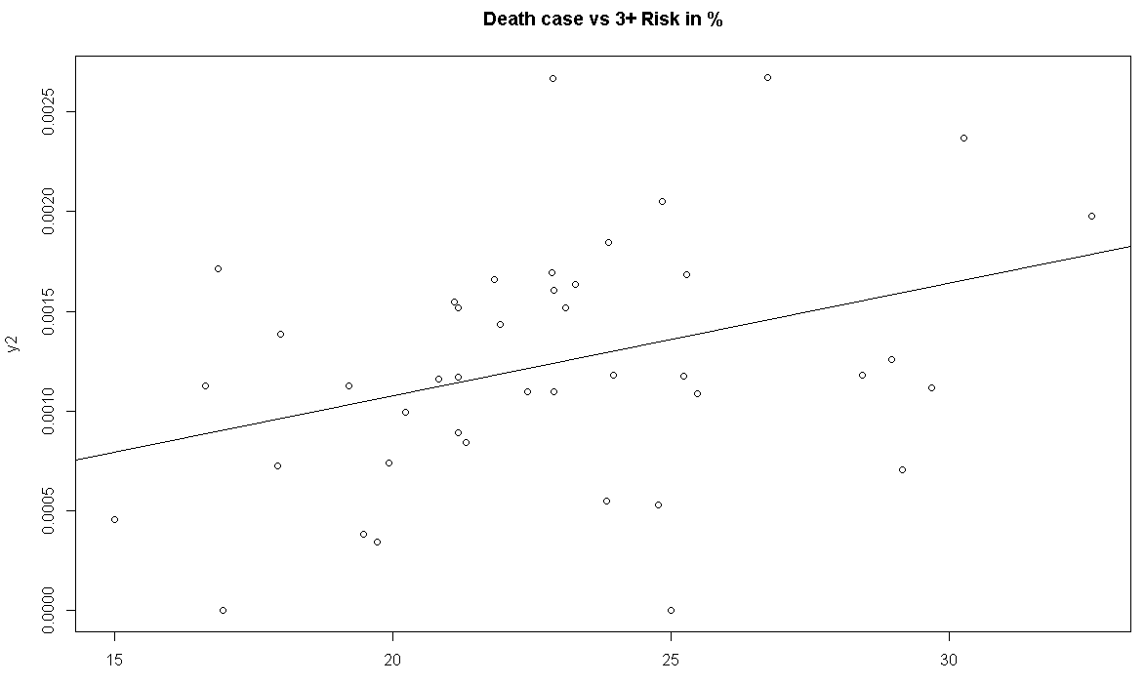

Slide 13
 | P value | R^2 | Slope
Y1~x11 | 0.06154 | 0.08267 | -0.0017933
Y1~X12 | 0.302 | 0.02596 | 0.001084
Y1~x13 | 0.3987 | 0.01743 | 0.0007877
Y2~X21 | 0.02977 | 0.1127 | -5.088e-05
Y2~~X22 | 0.9409 | 0.0001392 | -1.808e-06
Y2~X23 | 0.01913 | 0.1297 | 5.660e-05

